Slide 1
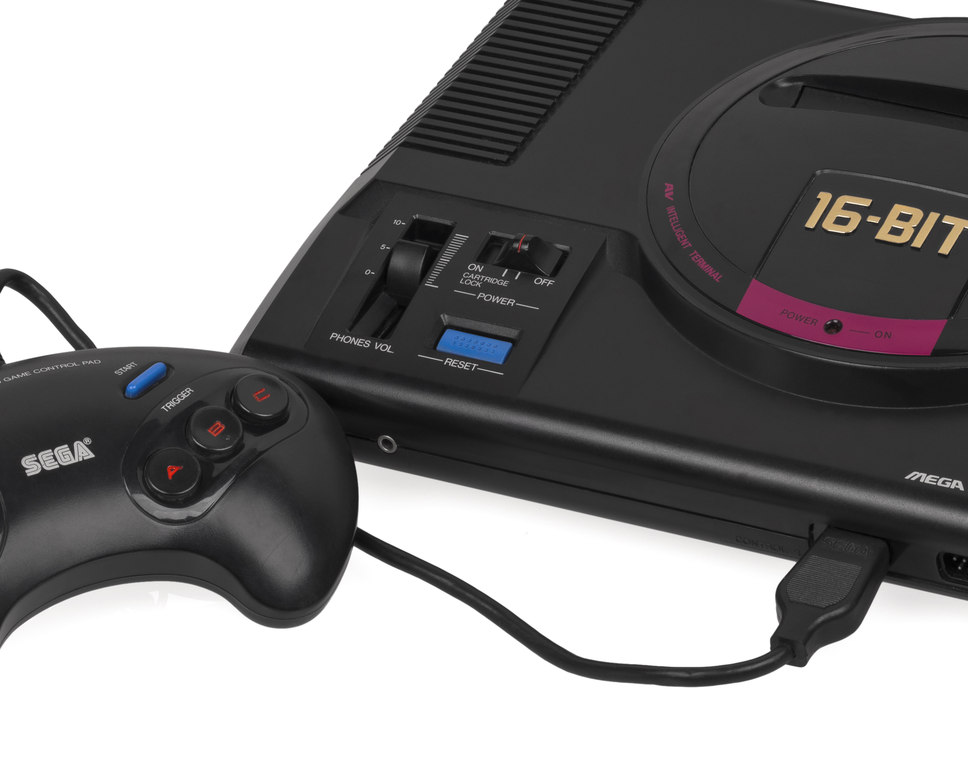
Red Light, Green Light
Or How I Learned to Stop Worrying and Love C

